Slide 1
INNOVATION LAB PROJECT
~ UNDER GUIDANCE OF
Dr. SOMENATH TRIPATHY SIR
BY-:
PUSPESH KUMAR 1801CS67
PRANAY KUMAR GUPTA 1801CS38

Slide 2
AIM:-
CREATE A Dapp WHERE WE CAN STORE INFORMATION REGARDING COVID-19 VIRUS SPREADING.

Slide 3
IMPLEMENTATION
THE COVID- 19 DETAILS OF ANY PLACE IS STORED IN A PUBLIC BLOCKCHAIN ( HERE, WE HAVE USE ROPSTEN PUBLIC TEST NETWORK WHICH IS BASED ON ETHEREUM). THE REASON OF SELECTING ROPSTEN WAS THAT IT IS A PUBLIC TESTNET SO WE DON’T HAVE TO SPEND ANY REAL ETHER ON IT.
FREE ETHER FOR ROPSTEN CAN BE OBTAINED FROM https://faucet.ropsten.be/

Slide 4
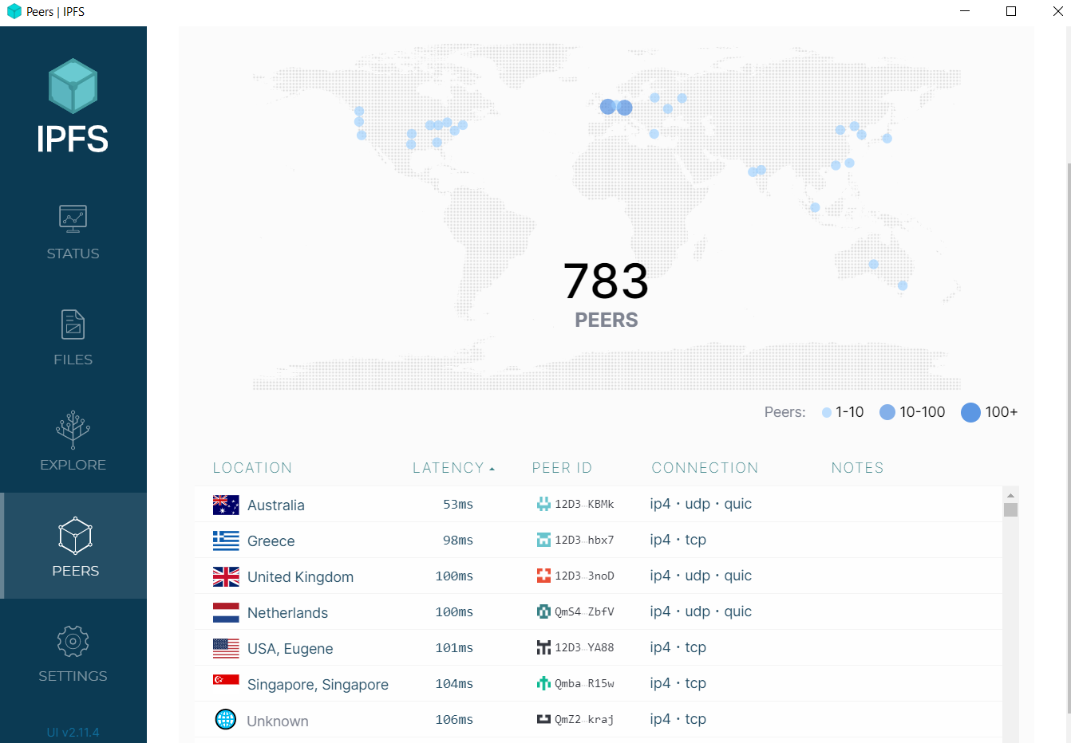
IT IS HOSTED BY IPNS( INTER PLANETARY NAMING SYSTEM) WHICH IS A PEER TO PEER NETWORK LIKE TORRENT.

Slide 5
HOW TO AVOID FAKE DATA OR DATA MANIPULATION BY AN USER?
TO AVOID DATA MANIPULATION / FAKE DATA , ABSTRACTION HAS BEEN USED. A NORMAL USER CAN ONLY SEE THE CONTENTS OF BLOCKCHAIN ( SEARCH COVID- 19 DETAILS OF ANY PLACE BUT CANNOT EDIT IT).

Slide 6
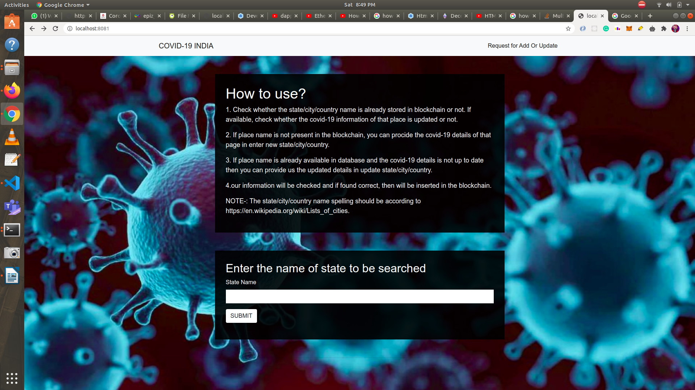
Workflow of the DAPP
The main page contains the instructions for the normal user. He can check if a data of a particular place exists or not using the search bar according to which he can add or update the record of the concerned place.

Slide 7
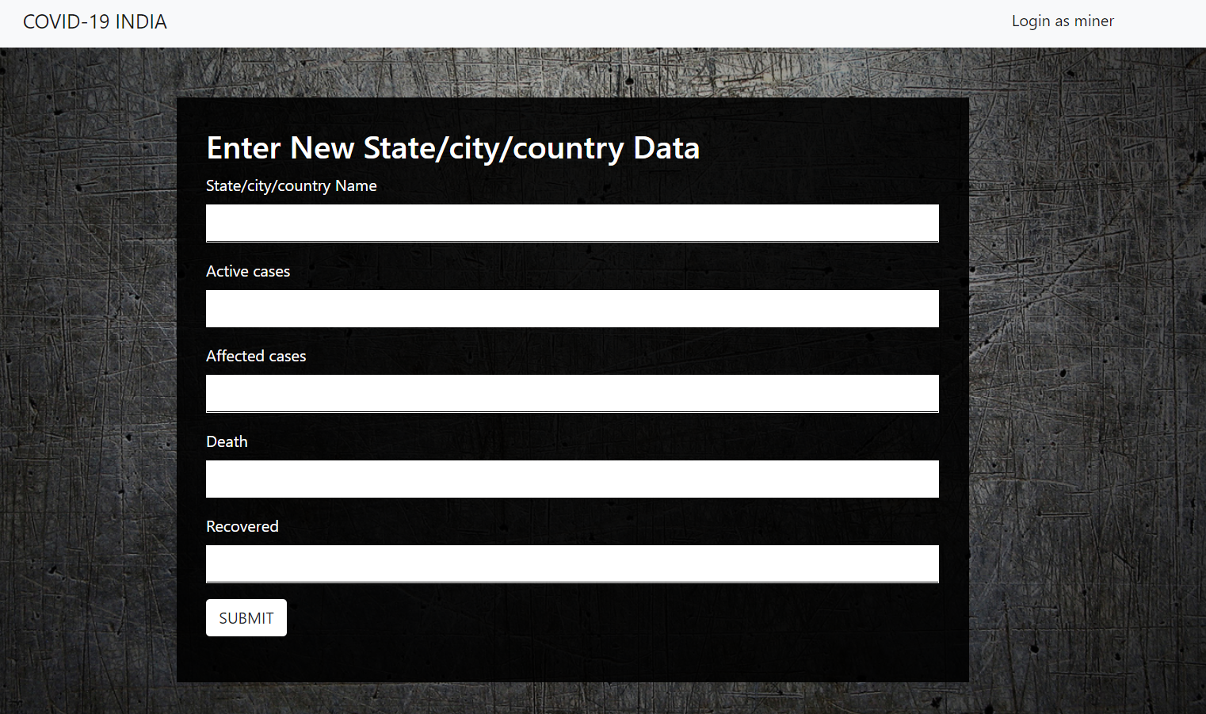
THE USER IS ALLOWED TO PROVIDE ENTRY FOR NEW PLACES OR UPDATE COVID- 19 DETAILS OF ANY EXISTING PLACE WHICH IS FIRST VERIFIED.

Slide 8
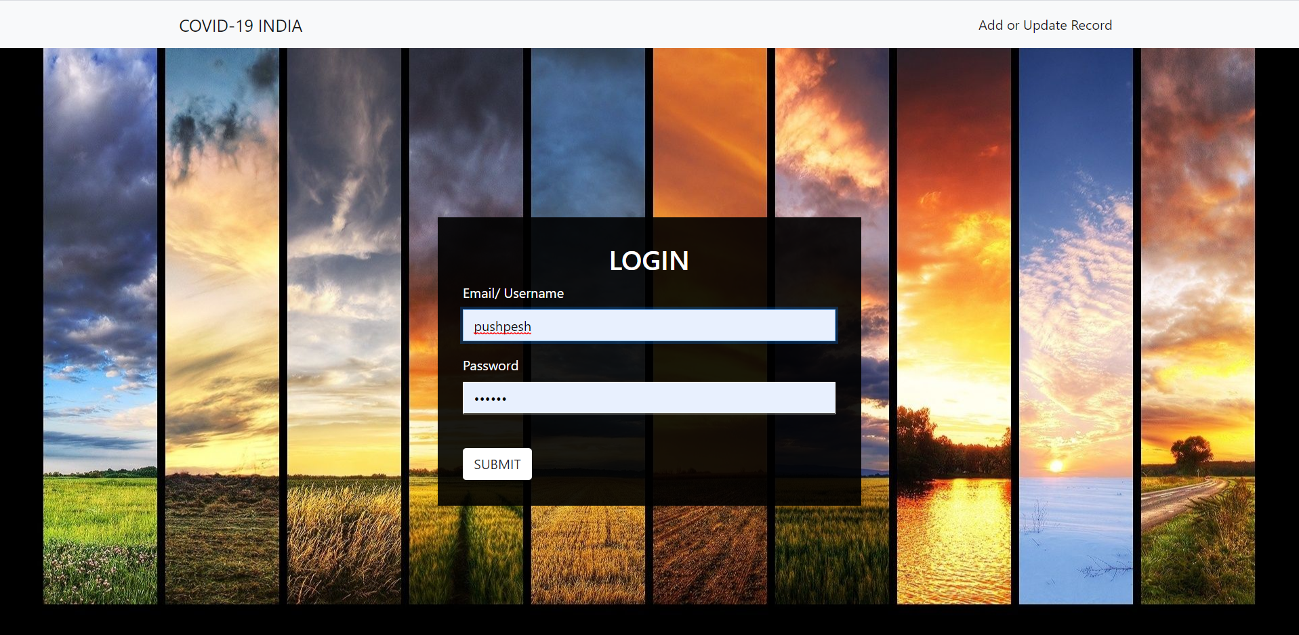
A group of authorized members can login and check all the addition or update request for various places.

Slide 9
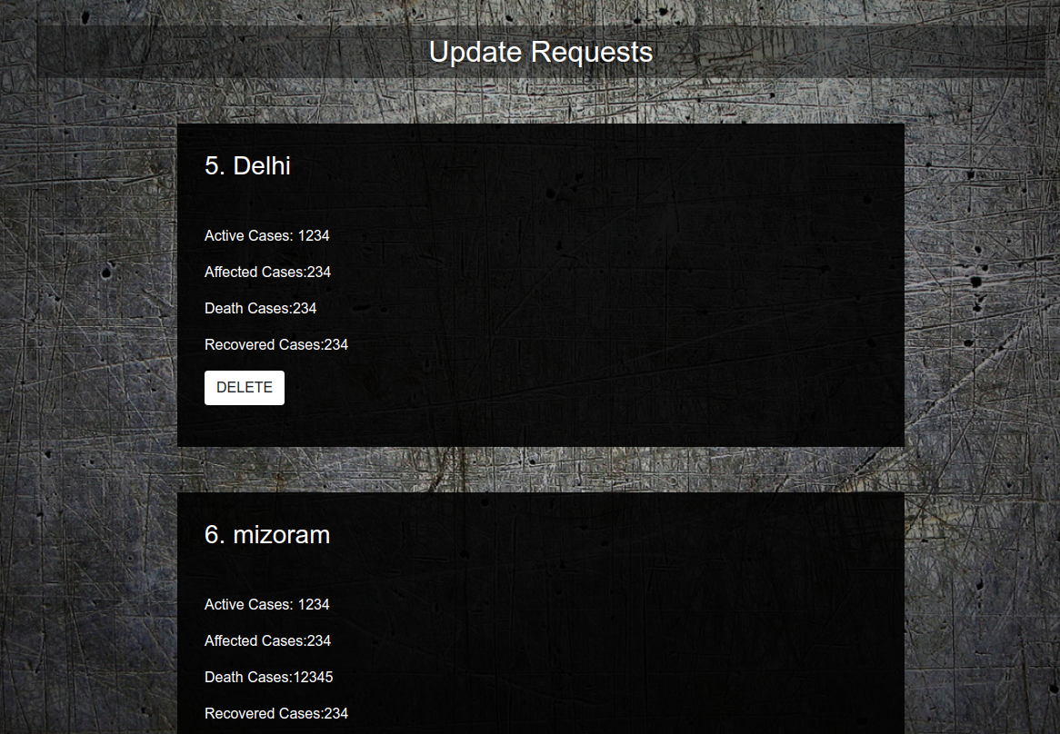
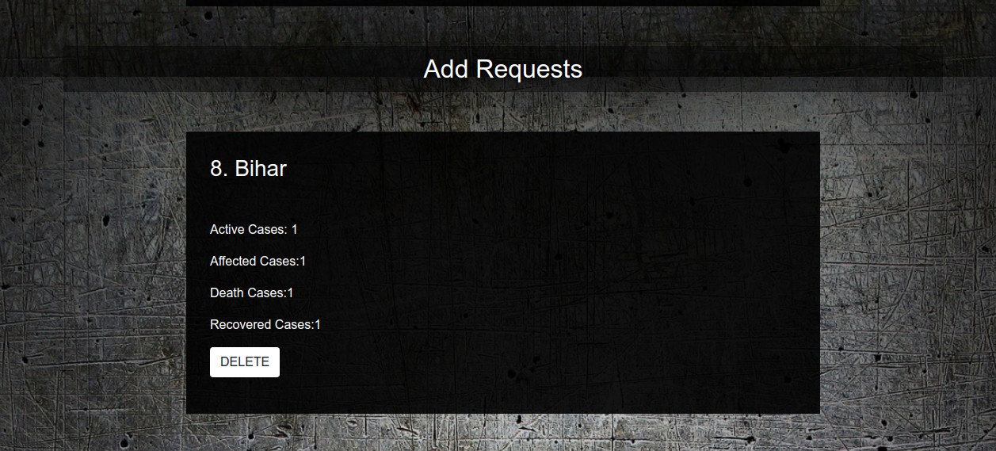
The addition or update request for various places are as shown in the figure.

Slide 10
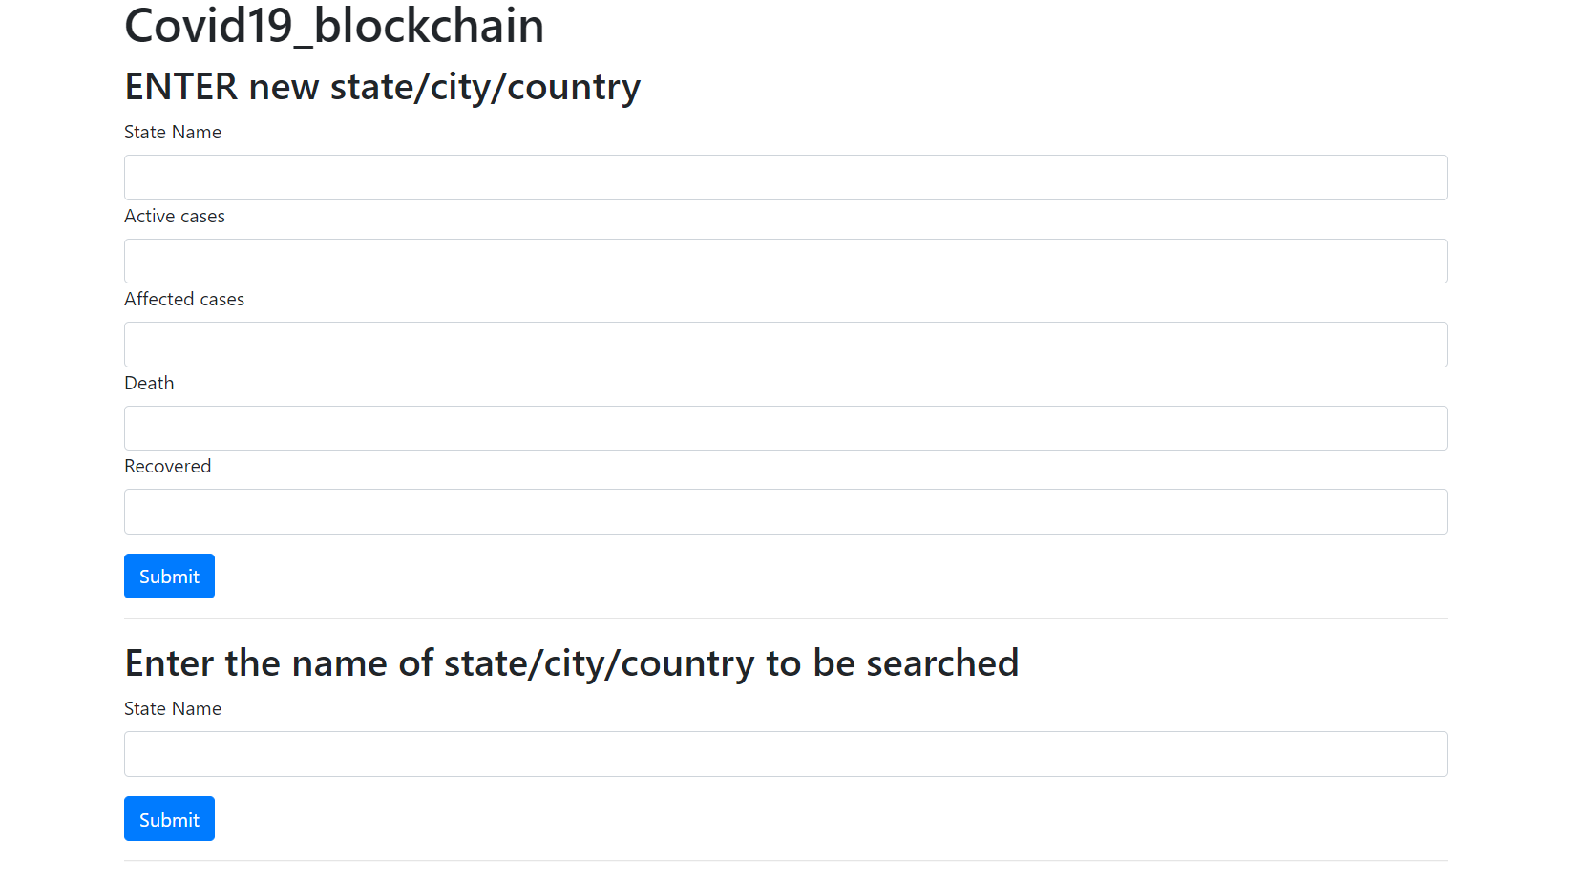
After checking the authenticity of the data authorized member hold the right to make add them to the blockchain and then delete the request from database.

Slide 11
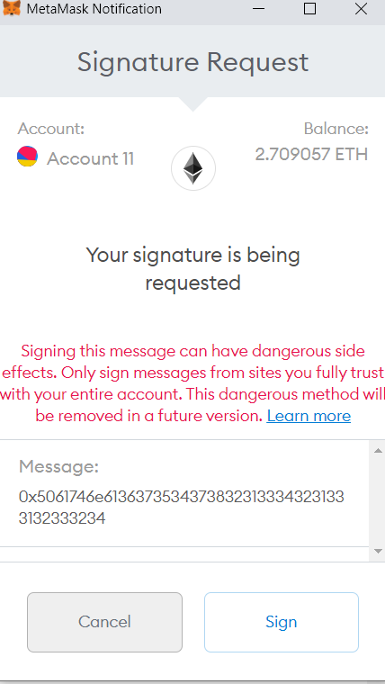
ANY TRANSACTION TO THE BLOCKCHAIN IS SIGNED FIRST TO AVOID ANY UNWANTED DATA MANIPULATION.

